Slide 1
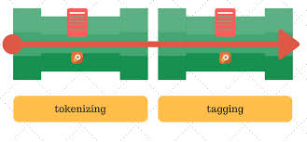

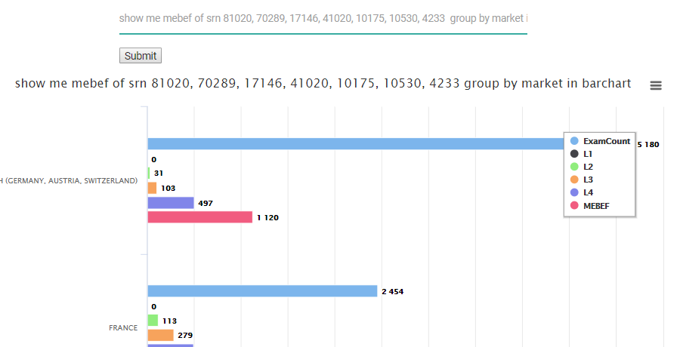
145 - Analytics Assistant using NLP | Voice Sunil Mandhan
Problem Instead of dashboard and KPIs tracking, talk to data in a natural and faster manner.
Value Proposition Focused information
Natural interaction
Quick response
Technology
Future Plan Prototype 1: NLP prototype
Prototype 2: NLP scope – complex analytics
Final Stage: Accuracy imp.
NLTK + CNN
Text Query
NLP features
AI based Analytics Assistant

